Slide 1
Two-wheeler loan Approval processing
Project Report
By: Karthik Barma

Slide 2
Problem Statement
Assume you are a loan risk officer at a large bank and you are tasked with determining whether a two-wheeler loan application will be accepted or rejected based on the data shared by the loan applicant and some additional data extracted about them from 3rd party sources.

Slide 3
Approach Taken
The project involved predicting whether a two-wheeler loan application would be approved or declined based on various applicant data. The steps taken in this project include:
Data Preprocessing:
Handling Missing Values: Numerical features were imputed using the mean strategy, while categorical features were imputed using the most frequent value.
Date Conversion: Date columns such as 'APPLICATION LOGIN DATE' and 'DOB' were converted into separate features representing year, month, and day.
Encoding Categorical Variables: Categorical features were encoded using OneHotEncoder for robust handling of categorical data, particularly with previously unseen labels.
Feature Alignment: Both training and test datasets were aligned to ensure they contained the same features.
Model Selection:
Four models were evaluated: Random Forest, Gradient Boosting, Logistic Regression, and Support Vector Machine (SVM).
Each model was integrated into a pipeline that included preprocessing and model training to ensure consistency.
Model Evaluation:
Cross-Validation: A 5-fold cross-validation was conducted to evaluate the performance of each model on the training dataset.
Hyperparameter Tuning: GridSearchCV was applied to the best-performing model (Logistic Regression) for fine-tuning.
Validation: The model was validated using a hold-out validation set to assess its performance in a real-world scenario

Slide 4
Insights and Conclusions from Data
Model Performance:
Logistic Regression emerged as the best model with a cross-validation accuracy of 0.8632, followed closely by SVM with 0.8574.
The Random Forest and Gradient Boosting models also performed well, with cross-validation accuracies of 0.8427and 0.8442 respectively.
Data Distribution:
The data was moderately imbalanced, with more loan applications being approved than declined. This is reflected in the prediction results where 1277 applications were predicted as approved and 723 as declined.
Feature Importance:
Logistic Regression suggests that the linear relationships among features are significant in predicting loan approval. This can be inferred from the fact that Logistic Regression outperformed other models that rely on non-linear relationships (like Random Forest and Gradient Boosting).

Slide 5
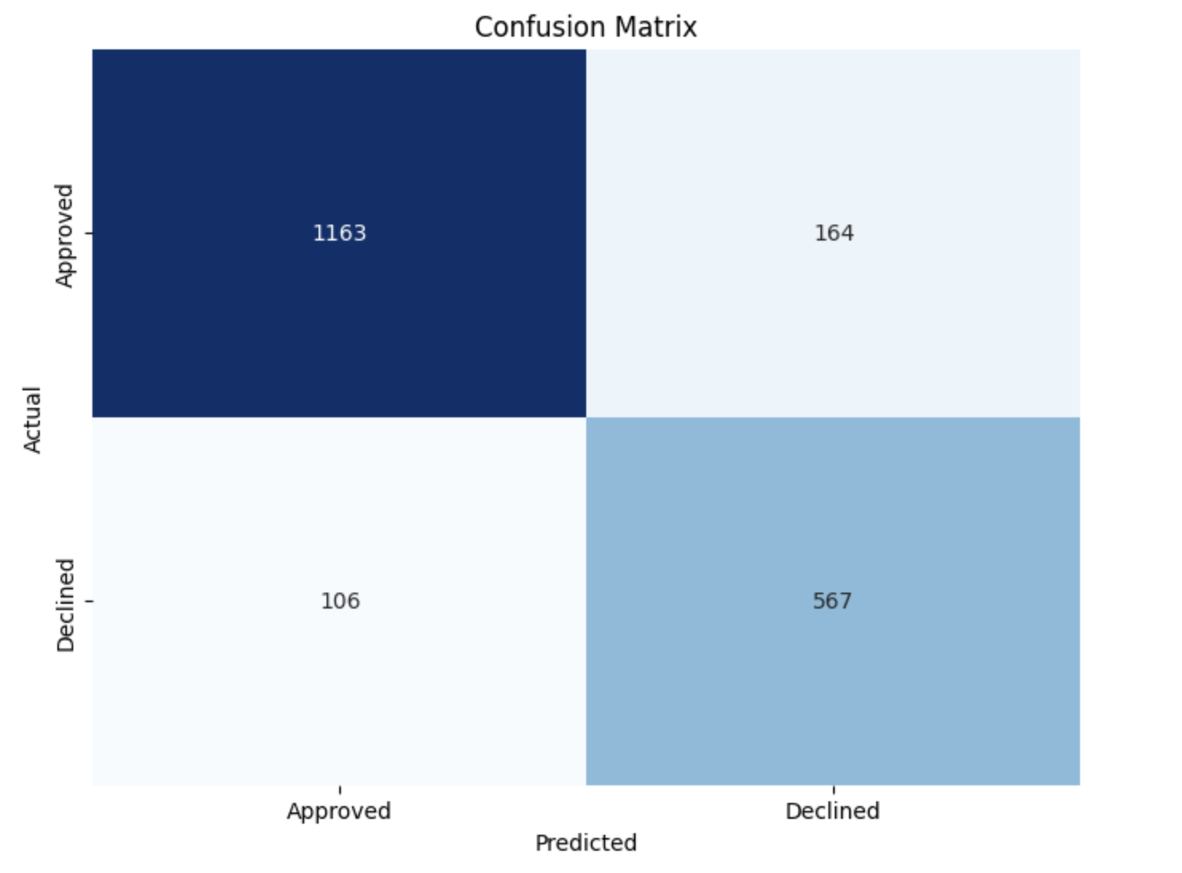
Performance on Train Data Set
Best Model : Logistic Regression
Validation Accuracy
86.32%

Slide 6
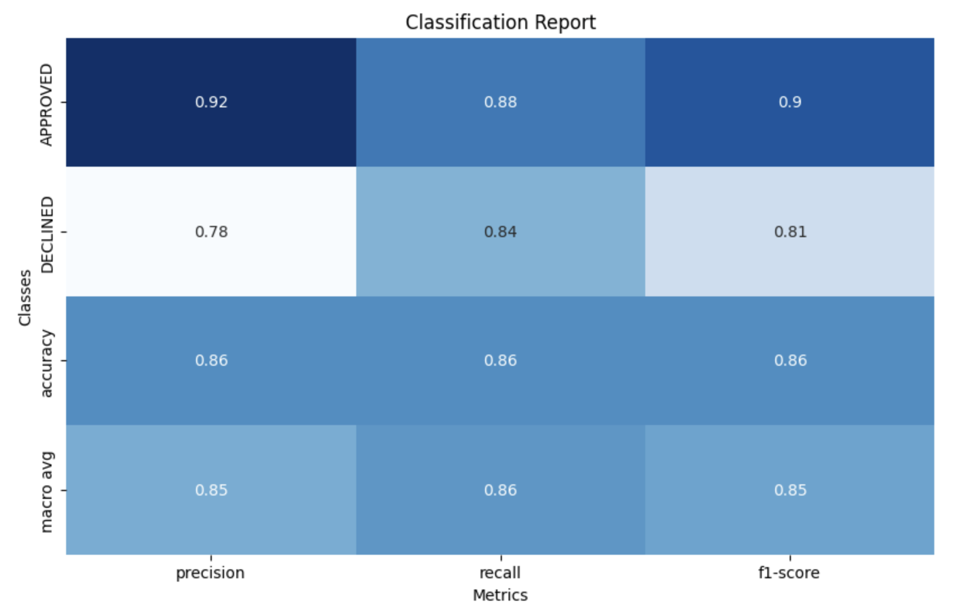
Performance on Train Data Set ..
Overall Accuracy
86.5%
Macro Avg F1 Score
85%

Slide 7
Use of Appropriate Metrics
Accuracy: Provides an overall measure of how many loan applications were correctly classified.
Precision and Recall: Precision measures how many applications predicted as approved are actually approved, while recall measures how many of the actual approved applications were correctly identified.
F1-Score: Combines precision and recall into a single metric to balance both, particularly important in cases of imbalanced data.
Confusion Matrix: Offers a detailed breakdown of true positives, true negatives, false positives, and false negatives, giving insight into the model's performance on each class.

Slide 8
Prediction Results Summary
Approved Loans
Declined Loans
Total Predictions
1277
723
2000

Slide 9
Conclusion
Logistic Regression was identified as the best model for this task, delivering the highest cross-validation accuracy and strong performance on the validation set.
The model was able to maintain a good balance between precision and recall, particularly in predicting the majority class (approved loans).
The methodology applied here could be further refined with more advanced feature engineering or alternative models if higher accuracy is required, especially for minority class predictions.

